Slide 1
Open Computing Language (OpenCL) Architecture and Programming
6 Hours
OpenCL - Benedict R. Gaster, Lee Howes, David R, Perhaad Mistry, Dana Schaa, “Heterogeneous Computing with OpenCL”, Elsevier Inc., 1st Edition, 2012.
22-02-2023
1

Slide 2
Topics covered:
Introduction to OpenCL
The OpenCL Specification
Kernels and OpenCL Execution Model
Steps in Executing an OpenCL program
Platform and Devices
The Execution Environment
Memory Model
Writing Kernels
Vector-vector Addition Example
22-02-2023
2

Slide 3
Introduction to OpenCL
Open Computing Language is a heterogeneous programming framework that is managed by Khronos group.
OpenCL is a framework for developing applications that execute across a range of device type made by different vendors.
OpenCL creates portable, vendor- and device-independent programs that are capable of being accelerated on many different hardware platforms.
The OpenCL API is a C with a C++ Wrapper API that is defined in terms of the C API.
The code that executes on an OpenCL device, which in general is not the same device as the host CPU, is written in the OpenCL C language.
22-02-2023
3

Slide 4
The OpenCL Specification
The OpenCL specification is defined in four parts, called models:
Platform model: Specifies that there is one processor coordinating execution (the host) and one or more processors capable of executing OpenCL C code (the devices). It defines an abstract hardware model that is used by programmers when writing OpenCL C functions (called kernels) that execute on the devices.
Execution model: Defines how the OpenCL environment is configured on the host and how kernels are executed on the device. This includes :
setting up an OpenCL context on the host
providing mechanisms for host–device interaction
defining a concurrency model used for kernel execution on devices.
Memory model: Defines the abstract memory hierarchy that kernels use, regardless of the actual underlying memory architecture. The memory model closely resembles current GPU memory hierarchies.
Programming model: Defines how the concurrency model is mapped to physical hardware.
OpenCL host-device model
22-02-2023
4

Slide 5
Steps in Executing an OpenCL Program
STEP 1: Discover and initialize the platforms
STEP 2: Discover and initialize the devices
STEP 3: Create a context
STEP 4: Create a command queue
STEP 5: Create device buffers
STEP 6: Write host data to device buffers
STEP 7: Create and compile the program
STEP 8: Create the kernel
STEP 9: Set the kernel arguments
STEP 10: Configure the work-item structure
STEP 11: Enqueue the kernel for execution
STEP 12: Read the output buffer back to the host
STEP 13: Release OpenCL resources
22-02-2023
5

Slide 6
Platform and Devices
The OpenCL platform model defines the roles of the host and devices and provides an abstract hardware model for devices.
In the platform model, there is a single host that coordinates execution on one or more devices.
Platforms are vendor-specific implementations of the OpenCL API. The devices that a platform can target are thus limited to those with which a vendor knows how to interact.
The platform model presents an abstract device architecture that programmers target when writing OpenCL C code. Vendors map this abstract architecture to the physical hardware.
the platform model defines a device as an array of compute units, with each compute unit functionally independent from the rest. Compute units are further divided into processing elements
OpenCL abstract architecture for devices
22-02-2023
6

Slide 7
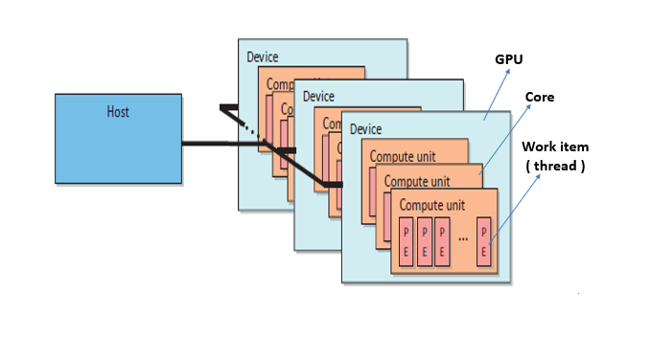

Slide 8
OpenCL specifications
It is defined in 4 parts called Models.
Platform Model: Specifies that there is one processor coordinating the execution (the host) and one or more processors capable of executing OpenCL C code(the devices).

Slide 9
STEP 1: Discover and initialize the platforms
The API function clGetPlatformIDs() is used to discover the set of available platforms for a given system.
This API is often called twice by an application :
The first call passes an unsigned int pointer as the num_platforms argument and NULL is passed as the platforms argument. The pointer is populated with the available number of platforms. The programmer can then allocate space to hold the platform information.
For the second call, a cl_platform_id pointer is passed with enough space allocated for num_entries platforms.
After platforms have been discovered, the clGetPlatformInfo() call can be used to determine which implementation (vendor) the platform was defined by.
cl_int clGetPlatformIDs(
cl_uint num_entries,
cl_platform_id *platforms,
cl_uint *num_platforms )
22-02-2023
9

Slide 10
STEP 1: Discover and initialize the platforms
cl_int clGetPlatformIDs(
cl_uint num_entries,
cl_platform_id *platforms,
cl_uint *num_platforms )
After platforms have been discovered, the clGetPlatformInfo() call can be used to determine which implementation (vendor) the platform was defined by.
cl_uint num_platforms = 0;
cl_platform_id *platforms = NULL;
// To get number of platforms
status= clGetPlatformIDs(0, NULL, &num_platforms);
// Allocate enough space for each platform
platforms=(cl_platform_id*) malloc (num_platforms*sizeof(cl_platform_id));
// To fill in Platforms info.
status=clGetPlatformIDs(num_platforms, platforms, NULL);
22-02-2023
10

Slide 11
STEP 2: Discover and Initialize the devices
The API function clGetDeviceIDs() is used to discover the set of available devices for a given system.
It works similar to clGetPlatformIDs() and takes the additional two arguments of a platform and a device type.
The device_type argument can be used to limit the devices to GPUs only (CL_DEVICE_TYPE_GPU), CPUs only (CL_DEVICE_TYPE_CPU), all devices (CL_DEVICE_TYPE_ALL)
As with platforms, clGetDeviceInfo() is called to retrieve information such as name, type, and vendor from each device.
cl_int clGetDeviceIDs(
cl_platform_id platform,
cl_device_type device_type,
cl_uint num_entries,
cl_device_id *devices,
cl_uint *num_devices )
22-02-2023
11

Slide 12
STEP 2: Discover and initialize the devices
cl_int clGetDeviceIDs(
cl_platform_id platform,
cl_device_type device_type,
cl_uint num_entries,
cl_device_id *devices,
cl_uint *num_devices )
cl_unit num_devices = 0;
cl_device_id *devices = NULL;
// To get number of devices
status=clGetDeviceIDs(platform[0], CL_DEVICE_TYPE_GPU, 0, NULL, &num_devices);
// Allocate enough space for each device
devices=(cl_device_id*) malloc (num_devices *sizeof(cl_device_id));
// To fill in Devices info.
status=clGetDeviceIDs(platform[0], CL_DEVICE_TYPE_GPU,num_devices,devices,NULL);
22-02-2023
12

Slide 13
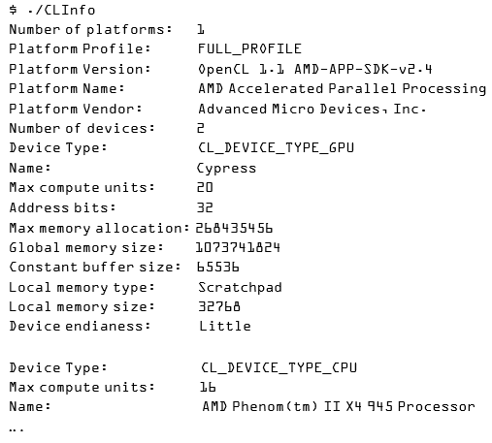
The CLInfo program in the AMD APP SDK uses the clGetPlatformInfo() and clGetDeviceInfo() commands to print detailed information about the OpenCL supported platforms and devices in a system.
22-02-2023
13

Slide 14
The Execution Environment
Before a host can request that a kernel be executed on a device, a context must be configured on the host that enables it to pass commands and data to the device.
Context:
Context is an abstract container that exists on the host and performs the following:
It coordinates the mechanisms for host-device interactions
It Manages the memory objects that are available to the devices
It Keeps track of the programs and kernels that are created for each device
22-02-2023
14

Slide 15
OpenCL specifications
Execution Model: Defines how the OpenCL environment is configured on the host and how kernels are executed on the device.
This includes
setting up on OpenCL context on the host
providing mechanisms for host-device interaction
Defining a concurrency model used for execution on devices

Slide 16
STEP 3: Create a context
The API function cl_context clCreateContext is used to discover the set of available devices for a given system.
The properties argument is used to restrict the scope of the context to a specific platform, enable graphics interoperability, or enable other parameters in the future.
The next two arguments specify the number and IDs of the devices that the programmer wants to associate with the context.
OpenCL allows user callbacks to report additional error information that might be generated throughout its lifetime.
cl_context clCreateContext (
const cl_context_properties *properties,
cl_uint num_devices,
const cl_device_id *devices,
void (CL_CALLBACK *pfn_notify)(
const char *errinfo,
const void *private_info,
size_t cb,
void *user_data),
void *user_data,
cl_int *errcode_ret)
22-02-2023
16

Slide 17
STEP 3: Create a context
cl_context clCreateContext (
const cl_context_properties *properties,
cl_uint num_devices,
const cl_device_id *devices,
void (CL_CALLBACK *pfn_notify)(
const char *errinfo,
const void *private_info,
size_t cb,
void *user_data),
void *user_data,
cl_int *errcode_ret)
After creating a context, the function clGetContextInfo() can be used to query information such as the number of devices present and the device structures.
Cl_int status
cl_context context = N U L L;
// Create a context and associate it with the devices
context = clCreateContext (
NULL,
numDevices,
devices,
NULL,
NULL,
&status);
22-02-2023
17

Slide 18
The Execution Environment
Command Queues:
Communication with a device occurs by submitting commands to a command queue.
Once the host decides which devices to work with and a context is created, one command queue needs to be created per device (i.e., each command queue is associated with only one device).
Whenever the host needs an action to be performed by a device, it will submit commands to the proper command queue.
22-02-2023
18

Slide 19
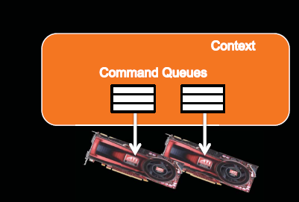

Slide 20
STEP 4: Create a command queue
The API function clCreateCommandQueue() is used to create a command queue and associate it with a device.
The properties parameter is a bit field that is used to enable profiling of commands :
CL_QUEUE_PROFILING_ENABLE to enable/disable profiling of commands (for performance analysis)
CL_QUEUE_OUT_OF_ ORDER_EXEC_MODE_ENABLE to allow out-of-order execution of commands
By default, it is in-order execution of commands
Any API that specifies host–device interaction will always begin with clEnqueue and require a command queue as a parameter.
cl_command_queue clCreateCommandQueue (
cl_context context,
cl_device_id device,
cl_command_queue_properties properties,
cl_int *errcode_ret )
22-02-2023
20

Slide 21
STEP 4: Create a command queue
cl_command_queue clCreateCommandQueue (
cl_context context,
cl_device_id device,
cl_command_queue_properties properties,
cl_int *errcode_ret )
cl_command_queue cmdQueue;
// Create a command queue and associate it with the device you want to execute on cmdQueue = clCreateCommandQueue(
context,
devices[0],
0,
&status);
22-02-2023
21

Slide 22
The Execution Environment
Memory Objects:
In OpenCL the data needs to be physically present on a device before execution can begin.
In order for data to be transferred to a device it must first be encapsulated as a memory object.
Whenever a memory object is created, it is valid only within a single context.
2 types:
buffers
images
Buffers are equivalent to arrays in C, created using malloc(), where data elements are stored contiguously in memory.
Images, on the other hand, are designed as opaque objects, allowing for data padding and other optimizations that may improve performance on devices.
22-02-2023
22

Slide 23
STEP 5: Create device buffers
The API function clCreateBuffer() allocates the buffer and returns a memory object:
Creating a buffer requires supplying the size of the buffer and a context in which the buffer will be allocated; it is visible for all devices associated with the context.
The host_ptr is used to initialize the buffer.
The flags parameter can take the following options:
CL_MEM_READ_ONLY
CL_MEM_WRITE_ONLY
CL_MEM_READ_WRITE
cl_mem clCreateBuffer(
cl_context context,
cl_mem_flags flags,
size_t size,
void *host_ptr,
cl_int *errcode_ret)
22-02-2023
23

Slide 24
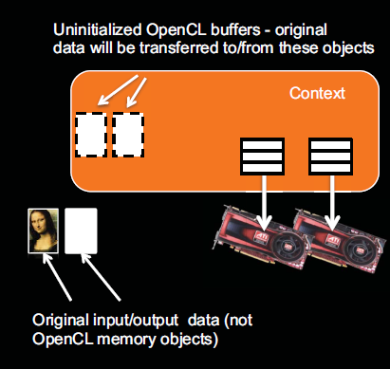

Slide 25
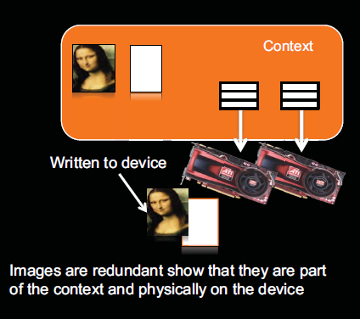

Slide 26
STEP 5: Create device buffers
cl_mem clCreateBuffer(
cl_context context,
cl_mem_flags flags,
size_t size,
void *host_ptr,
cl_int *errcode_ret)
cl_mem bufferA; // Input array on the device
cl_mem bufferB; // Input array on the device
cl_mem bufferC; // Output array on the device
// Create a buffer object that will contain the data from the host array A
bufferA = clCreateBuffer( context, CL_MEM_READ_ONLY, datasize, NULL, &status);
// Create a buffer object that will contain the data from the host array B
bufferB = clCreateBuffer( context, CL_MEM_READ_ONLY, datasize, NULL, &status);
// Create a buffer object with enough space to hold the output data
bufferC = clCreateBuffer( context, CL_MEM_WRITE_ONLY, datasize, NULL, &status);
size_t datasize = sizeof(int)*elements;
22-02-2023
26

Slide 27
Step 6:Write host data to device buffers
Vector-vector addition
CPU Memory
N=9
Input A = {1, 2, 3,4,5,6,7,6,7}
Input B = {4, 5, 6,1,2,3,1,2,2}
Output C = { }
Output C = {5, 7, 9,5,7.9,8,8,9} //final output
clCreateBuffer -
BufferA – CL_MEM_READ_ONLY BufferB – CL_MEM_READ_ONLY BufferC - CL_MEM_WRITE_ONLY

Slide 28
STEP 6: Write host data to device buffers
Data contained in host memory is transferred to and from an OpenCL buffer using the commands clEnqueueWriteBuffer() and clEnqueueReadBuffer(), respectively.
The API calls for reading and writing to buffers are very similar.
Parameters:
command_queue refers to the command-queue in which the write command will be queued
blocking_write indicates if the write operation is blocking (CL_TRUE ) or nonblocking (CL_FALSE )
offset in bytes in the buffer object to write to
cb is the size in bytes of data being written
cl_int clEnqueueWriteBuffer (
cl_command_queue command_queue,
cl_mem buffer,
cl_bool blocking_write,
size_t offset,
size_t cb,
const void *ptr,
cl_uint num_events_in_wait_list,
const cl_event *event_wait_list,
cl_event *event)
22-02-2023
28

Slide 29
STEP 6: Write host data to device buffers
Parameters:
ptr refers to the pointer to buffer in host memory where data is to be written from
event_wait_list, num_events_in_wait_list parameters specify events that need to complete before this particular command can be executed. If event_wait_list is NULL, then this particular command does not wait on any event to complete. If event_wait_list is NULL, num_events_in_wait_list must be 0. If event_wait_list is not NULL, the list of events pointed to by event_wait_list must be valid and num_events_in_wait_list must be greater than 0
event returns an event object
cl_int clEnqueueWriteBuffer (
cl_command_queue command_queue,
cl_mem buffer,
cl_bool blocking_write,
size_t offset,
size_t cb,
const void *ptr,
cl_uint num_events_in_wait_list,
const cl_event *event_wait_list,
cl_event *event)
22-02-2023
29

Slide 30
STEP 6: Write host data to device buffers
cl_int clEnqueueWriteBuffer (
cl_command_queue command_queue,
cl_mem buffer,
cl_bool blocking_write,
size_t offset,
size_t cb,
const void *ptr,
cl_uint num_events_in_wait_list,
const cl_event *event_wait_list,
cl_event *event)
// Write input array A to the device buffer bufferA
status = clEnqueueWriteBuffer( comdq2, bufferA, CL_FALSE, 0, datasize, A, 0, NULL, NULL); // Write input array B to the device buffer bufferB
status = clEnqueueWriteBuffer( cmdQueue, bufferB, CL_FALSE, 0, datasize, B, 0, NULL, NULL);
22-02-2023
30

Slide 31
Step 6:Write host data to device buffers
clCreateBuffer -
BufferA – CL_MEM_READ_ONLY BufferB – CL_MEM_READ_ONLY BufferC - CL_MEM_WRITE_ONLY
clEnqueueWriteBuffer
BufferA = {1, 2, 3,4,5,6,7,6,7}
BufferB = {4, 5, 6,1,2,3,1,2,2}

Slide 32
Kernels and the OpenCL execution model
Kernels are the parts of an OpenCL program that actually execute on a device.
An OpenCL kernel is syntactically similar to a standard C function; the key difference is a set of additional keywords and the execution model that OpenCL kernels implement.
When developing concurrent programs for a CPU, the programmer considers the physical resources available (e.g., CPU cores) and the overhead of creating and switching between threads.
With OpenCL, the goal is often to represent parallelism programmatically at the finest granularity possible.
22-02-2023
32

Slide 33
Example:- Element-wise vector addition
1. Serial C implementation:
// Perform an element-wise addition of A and B and store in C
// There are N elements per array
void vecadd (int *C, int* A, int *B, int N)
{
for(int i = 0; i < N; i++)
{
C[i] = A[i] + B[i];
}
}
22-02-2023
33

Slide 34
2. Thread C implementation:
A coarse-grained, multithreaded version code for a multi-core device require dividing the work (i.e., loop iterations) between the threads.
// Perform element-wise addition of A & B and store in C
// There are N elements per array and N_{P} CPU cores
void vecadd (int *C, int* A, int *B, int N, int N_{P}, int tid)
{
int ept = N/N_{P}; // elements per thread
for (int i = tid*ept; i < (tid+1)*ept; i++)
{
C[i] = A[i] + B[i];
}
}
* Because there may be a large number of loop iterations and the work per iteration is small, we chunk the loop iterations into a larger granularity (a technique called strip mining)
22-02-2023
34

Slide 35
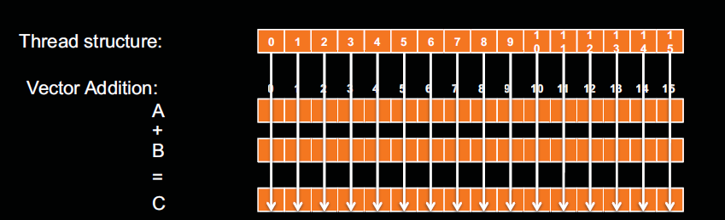

Slide 36
3. OpenCL implementation (kernel):
The unit of concurrent execution in OpenCL is a work-item (WI).
Each WI executes the kernel function body.
We map a single iteration of the loop to a WI.
We tell the OpenCL runtime to generate as many WIs as elements in the input and output arrays and allow the OpenCL to map those WIs to the underlying hardware, (CPU / GPU cores).
When an OpenCL device begins executing a kernel, it allow the programmer to identify the position of the current WI using a call to OpenCL API get_global_id(0).
// N work-items will be created to execute this kernel
__kernel void vecadd (__global int *C, __global int* A, __global int *B)
{
int tid = get_global_id(0); // OpenCL intrinsic function
C[tid] = A[tid] + B[tid];
}
global-id Vs local-id
22-02-2023
36

Slide 37
3. OpenCL implementation (kernel):
When a kernel is executed, the programmer specifies the number of work-items that should be created as an n-dimensional range (NDRange).
An NDRange is a one-, two-, or three-dimensional array of work-items that will often map to the dimensions of either the input or the output data.
Example: size_t WorkItemsSize[3] = {1024, 1, 1)
For achieving scalability, OpenCL divides the work-items of an NDRange into smaller, equally sized workgroups.
Example: size_t workGroupSize[3] = {64, 1, 1)
* This results in creating 16 work- groups (1024 work-items/(64 work-items per workgroup) =16 workgroups)
workItems-workGroup
22-02-2023
37

Slide 38
The Execution Environment
Creating an OpenCL program object:
OpenCL C code (written to run on an OpenCL device) is called a program.
A program is a collection of functions called kernels, where kernels are units of execution that can be scheduled to run on a device.
OpenCL programs are compiled at runtime through a series of API calls.
This runtime compilation gives the system an opportunity to optimize for a specific device.
The process of creating a kernel is as follows:
The OpenCL C source code is stored in a character string. If the source code is stored in a file on a disk, it must be read into memory and stored as a character array.
The source code is turned into a program object, cl_program, by calling clCreate ProgramWithSource().
The program object is then compiled, for one or more OpenCL devices, with clBuildProgram(). If there are compile errors, they will be reported here.
22-02-2023
38

Slide 39
The Execution Environment
Transferring kernel code to a character array The OpenCL C source code is stored in a character string
#define MAX_SOURCE_SIZE (0x100000)
FILE *fp;
char *source_str;
size_t source_size;
fp = fopen("vector_add_kernel.cl", "r");
if (!fp) {
fprintf(stderr, "Failed to load kernel.\n");
exit(1);
}
source_str = (char*)malloc(MAX_SOURCE_SIZE);
source_size = fread( source_str, 1, MAX_SOURCE_SIZE, fp);
fclose( fp );
const char* programSource =
“__kernel \n”
“void vecadd(__global int *A, \n”
“ __global int *B, \n”
“ __global int *C) \n”
“{ \n”
“ \n”
“ // Get the work-item’s unique ID \n”
“ int idx = get_global_id(0); \n”
“ \n”
“ // Add the corresponding locations of \n”
“ // ’A’ and ’B’, and store the result in ’C’. \n”
“ C[idx] ¼ A[idx] + B[idx]; \n”
“} \n”
;
22-02-2023
39

Slide 40
STEP 7: Create and compile the program
The API function clCreateProgramWithSource() is used to create a OpenCL program with source code.
Parameters:
program is the program object
context is a valid context
strings An array of count pointers to optionally null-terminated character strings that make up the source code
lengths An array with the number of chars in each string (the string length). If an element in lengths is zero, its accompanying string is null-terminated. If lengths is NULL, all strings in the strings argument are considered null-terminated
cl_program clCreateProgramWithSource(
cl_context context,
cl_uint count,
const char **strings,
const size_t *lengths,
cl_int *errcode_ret);
22-02-2023
40

Slide 41
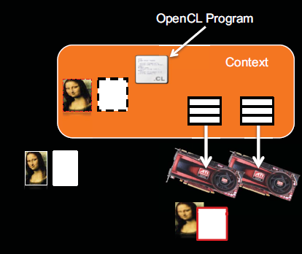

Slide 42
STEP 7: Create and compile the program
The API function clBuildProgram()is used to build (compile) the program for the connected devices.
Parameters:
program is the program object
num_devices is the number of devices listed in device_list
device_list is a pointer to a list of devices that are in program
options is a pointer to a string that describes the build options to be used for building the program executable
pfn_notify is a function pointer to a notification routine. The notification routine is a callback function that an application can register and which will be called when the program executable has been built (successfully or unsuccessfully)
User_data is passed as an argument when pfn_notify is called
cl_int clBuildProgram(
cl_program program,
cl_uint num_devices,
cl_device_id * device_list,
const char *options,
void (pfn_notify *) (cl_program, void *user_data),
void *user_data)
22-02-2023
42

Slide 43
STEP 7: Create and compile the program
cl_program clCreateProgramWithSource(
cl_context context,
cl_uint count,
const char **strings,
const size_t *lengths,
cl_int *errcode_ret);
cl_int clBuildProgram(
cl_program program,
cl_uint num_devices,
cl_device_id * device_list,
const char *options,
void (pfn_notify *) (cl_program, void *user_data),
void *user_data)
// Create a program
cl_program program = clCreateProgramWithSource( context, 1, (const char**)&programSource, NULL, &status);
// Build (compile) the program for the devices
status = clBuildProgram( program, numDevices, devices, NULL, NULL, NULL);
22-02-2023
43

Slide 44
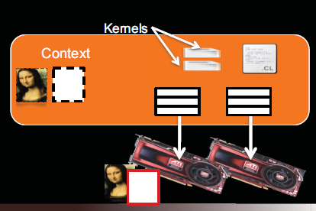

Slide 45
The Execution Environment
The OpenCL Kernel
The final stage in program execution is to obtain a cl_kernel object that can be used to execute kernels on a device by extracting the kernel from the cl_program.
The name of the kernel is passed to clCreateKernel(), along with the program object, and the kernel object will be returned if the program object was valid, and the particular kernel is found.
cl_kernel clCreateKernel(
cl_program program,
const char *kernel_name ,
cl_int *errcode_ret);
22-02-2023
45

Slide 46
STEP 8: Create the kernel
__kernel void vecadd (__global int *C, __global int* A, __global int *B)
{
int tid = get_global_id(0); // OpenCL intrinsic function
C[tid] = A[tid] + B[tid];
}
--kernel void k1(…….)
cl_kernel clCreateKernel(
cl_program program,
const char *kernel_name ,
cl_int *errcode_ret);
22-02-2023
46

Slide 47
STEP 8: Create the kernel
__kernel void vecadd (__global int *C, __global int* A, __global int *B)
{
int tid = get_global_id(0); // OpenCL intrinsic function
C[tid] = A[tid] + B[tid];
}
--kernel void k1(…….)
cl_kernel clCreateKernel(
cl_program program,
const char *kernel_name ,
cl_int *errcode_ret);
cl_kernel kernel = NULL;
// Create a kernel from the vector addition function (named "vecadd") kernel = clCreateKernel(program, "vecadd", &status);
22-02-2023
47

Slide 48
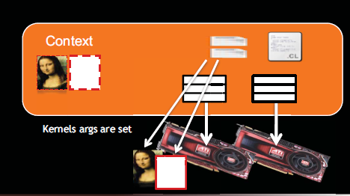

Slide 49
STEP 9: Set the kernel arguments
Executing a kernel requires dispatching it through an enqueue function.
We must specify each kernel argument individually using the function clSetKernelArg().
This function takes a kernel object, an index specifying the argument number, the size of the argument, and a pointer to the argument.
We must specify each kernel argument individually using the function clSetKernelArg().
When the kernel is executed, this information is used to transfer arguments to the device.
cl_int clSetKernelArg(
cl_kernel kernel,
cl_uint arg_index ,
size_t arg_size,
const void *arg_value);
22-02-2023
49

Slide 50
STEP 9: Set the kernel arguments
__kernel void vecadd (__global int *C, __global int* B, __global int *A)
{
int tid = get_global_id(0); // OpenCL intrinsic function
C[tid] = A[tid] + B[tid];
}
cl_int clSetKernelArg(
cl_kernel kernel,
cl_uint arg_index ,
size_t arg_size,
const void *arg_value);
22-02-2023
50

Slide 51
STEP 9: Set the kernel arguments
__kernel void vecadd (__global int *A, __global int* B, __global int *C)
{
int tid = get_global_id(0); // OpenCL intrinsic function
C[tid] = A[tid] + B[tid];
}
cl_int clSetKernelArg(
cl_kernel kernel,
cl_uint arg_index ,
size_t arg_size,
const void *arg_value);
// Associate the input and output buffers with the kernel
status = clSetKernelArg( kernel, 0, sizeof(cl_mem), &bufferA);
status |= clSetKernelArg( kernel, 1, sizeof(cl_mem), &bufferB);
status |= clSetKernelArg( kernel, 2, sizeof(cl_mem), &bufferC);
22-02-2023
51

Slide 52
3. OpenCL implementation (kernel):
The unit of concurrent execution in OpenCL is a work-item (WI).
Each WI executes the kernel function body.
We map a single iteration of the loop to a WI.
We tell the OpenCL runtime to generate as many WIs as elements in the input and output arrays and allow the OpenCL to map those WIs to the underlying hardware, (CPU / GPU cores).
When an OpenCL device begins executing a kernel, it allow the programmer to identify the position of the current WI using a call to OpenCL API get_global_id(0).
// N work-items will be created to execute this kernel
__kernel void vecadd (__global int *C, __global int* A, __global int *B)
{
int tid = get_global_id(0); // OpenCL intrinsic function
C[tid] = A[tid] + B[tid];
}
global-id Vs local-id
22-02-2023
52

Slide 53
3. OpenCL implementation (kernel):
When a kernel is executed, the programmer specifies the number of work-items that should be created as an n-dimensional range (NDRange).
An NDRange is a one-, two-, or three-dimensional array of work-items that will often map to the dimensions of either the input or the output data.
Example: size_t WorkItemsSize[3] = {1024, 1, 1)
For achieving scalability, OpenCL divides the work-items of an NDRange into smaller, equally sized workgroups.
Example: size_t workGroupSize[3] = {64, 1, 1)
* This results in creating 16 work- groups (1024 work-items/(64 work-items per workgroup) =16 workgroups)
workItems-workGroup
22-02-2023
53

Slide 54
STEP 10: Configure the work-item structure
// Define an index space (global work size) of work items for execution. // A workgroup size (local work size) is not required, but can be used. size_t globalWorkSize[1];
// There are ’elements(1024)’ work-items
globalWorkSize[0] = elements;
Work Dimension is 1 and global_work_size (GSZ)=1024
local_work_size (LSZ)=128
Since there are 1024 total work-items and 128 work-items / work-group, there are :
1024 / 128 = 8 work-groups (WG).
22-02-2023
54

Slide 55
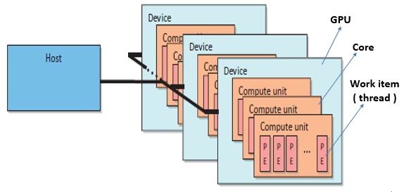
STEP 10: Configure the work-item structure
N = 9 Global work size = 9 local work size = 1
Work groups = 9 / 1 = 9
C[0] C[1] C[2] C[8]

Slide 56
STEP 10: Configure the work-item structure
N = 9 Global work size = 9 local work size = 1
Work groups = 9 / 1 = 9
N = 9 Global work size = 9 local work size = 3
Work groups = 9 / 3 = 3
c[0],c[1],c[2] c[3],c[4],c[5] c[6],c[7],c[8]

Slide 57
STEP 11: Enque the kernel for execution
After any required memory objects are transferred to the device and the kernel arguments are set, the kernel is ready to be executed.
We can request that a device begin executing a kernel with a call to clEnqueueNDRangeKernel().
Four fields are related to work-item creation:
work_dim: Specifies the number of dimensions in which work-item will be created
global_work_size: Specifies the number of work items in each dimension of the ND range
local_work_size: Specifies the number of work items in each dimension of the workgroup
global_work_offset: Used to provide global IDs to the work items that do not start from zero
cl_int clEnqueueNDRangeKernel(
cl_command_queue command_queue,
cl_kernel kernel,
cl_uint work_dim,
const size_t *global_work_offset,
const size_t *global_work_size,
const size_t *local_work_size,
cl_uint num_events_in_wait_list,
const cl_event *event_wait_list,
cl_event *event)
22-02-2023
57

Slide 58
STEP 11: Enque the kernel for execution
The clEnqueueNDRangeKernel() call is asynchronous: it will return immediately after the command is enqueued in the command queue
cl_int clEnqueueNDRangeKernel(
cl_command_queue command_queue,
cl_kernel kernel,
cl_uint work_dim,
const size_t *global_work_offset,
const size_t *global_work_size,
const size_t *local_work_size,
cl_uint num_events_in_wait_list,
const cl_event *event_wait_list,
cl_event *event)
22-02-2023
58

Slide 59
STEP 11: Enque the kernel for execution
The clEnqueueNDRangeKernel() call is asynchronous: it will return immediately after the command is enqueued in the command queue
cl_int clEnqueueNDRangeKernel(
cl_command_queue command_queue,
cl_kernel kernel,
cl_uint work_dim,
const size_t *global_work_offset,
const size_t *global_work_size,
const size_t *local_work_size,
cl_uint num_events_in_wait_list,
const cl_event *event_wait_list,
cl_event *event)
//Execute the kernel
status = clEnqueueNDRangeKernel( cmdQueue,
kernel,
1,
NULL,
globalWorkSize,
NULL,
0,
NULL,
NULL);
22-02-2023
59

Slide 60
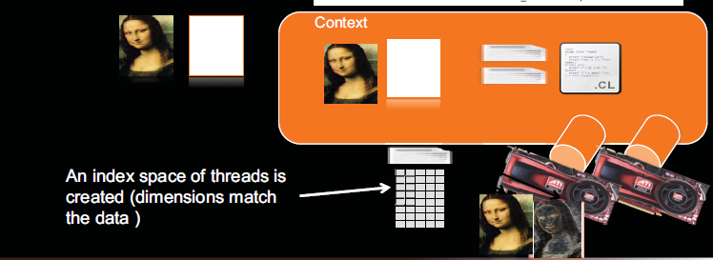

Slide 61
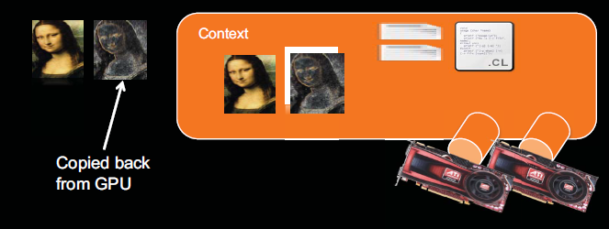

Slide 62
STEP 12: Read the output buffer back to the host
Once the result is computed by the device, it is placed in the output buffer from where the host read it by calling clEnqueueReadBuffer().
cl_int clEnqueueReadBuffer (
cl_command_queue command_queue,
cl_mem buffer,
cl_bool blocking_write,
size_t offset,
size_t cb,
const void *ptr,
cl_uint num_events_in_wait_list,
const cl_event *event_wait_list,
cl_event *event)
22-02-2023
62

Slide 63
STEP 12: Read the output buffer back to the host
cl_int clEnqueueReadBuffer (
cl_command_queue command_queue,
cl_mem buffer,
cl_bool blocking_write,
size_t offset,
size_t cb,
const void *ptr,
cl_uint num_events_in_wait_list,
const cl_event *event_wait_list,
cl_event *event)
// Read the OpenCL output buffer (bufferC) to the host output array (C)
clEnqueueReadBuffer( cmdQueue, bufferC, CL_TRUE, 0, datasize, C, 0, NULL, NULL);
// Verify the output
bool result = true;
for(int i = 0; i < elements; i++)
{ if(C[i] != i+i)
{ result = false;
break;
} }
if(result)
printf("Output is correct\n");
else
printf("Output is incorrect\n");
22-02-2023
Bhargav Bhatkalkar
63

Slide 64
STEP 13: Release OpenCL resources
The final step in OpenCL program execution is to release all the resources held by the program before the termination
// Free OpenCL resources
clReleaseKernel(kernel);
clReleaseProgram(program);
clReleaseCommandQueue(cmdQueue);
clReleaseMemObject(bufferA);
clReleaseMemObject(bufferB);
clReleaseMemObject(bufferC);
clReleaseContext(context);
// Free host resources
free(A);
free(B);
free(C);
free(platforms);
free(devices);
22-02-2023
64

Slide 65
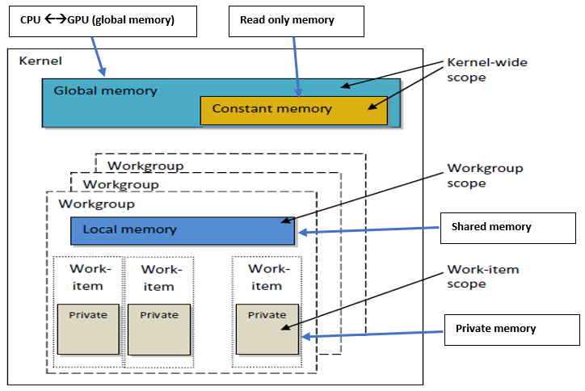
Memory Model
To support code portability, OpenCL’s approach is to define an abstract memory model that programmers can target when writing code and vendors can map to their actual memory hardware.
22-02-2023
65

Slide 66
Memory Model
Global memory:
It is visible to all compute units on the device (similar to the main memory on a CPU-based host system).
Whenever data is transferred from the host to the device OR from the device to the host, it must reside in global memory.
The keyword __global is added to a pointer declaration to specify that data referenced by the pointer resides in global memory.
example: __global float* A
Constant memory:
It is specifically designed for data where each element is accessed simultaneously by all work-items.
Variables whose values never change (e.g., a data variable holding the value of π) also fall into this category.
Constant memory is modeled as a part of global memory, so memory objects that are transferred to global memory can be specified as constant.
Data is mapped to constant memory by using the __constant keyword.
22-02-2023
66

Slide 67
Memory Model
Local memory:
It is a scratchpad memory whose address space is unique to each compute device.
Local memory is modeled as being shared by a workgroup.
Inside a GPU, all work items of the same work group must be executed on a single "core".
You can synchronize threads (work items) inside a work group, because they all are resident in the same core.
Data is mapped to local memory by using the __local keyword.
Private memory:
This memory is unique to an individual work-item.
Local variables and nonpointer kernel arguments are private by default.
22-02-2023
67

Slide 68
Writing Kernels
OpenCL C kernels are similar to C functions.
Kernel will be executed once for every work-item created.
Kernels begin with the keyword __kernel and must have a return type of void.
Buffers can be declared in global memory (__global) or constant memory (__constant).
Kernel arguments can also use optional access qualifiers (__read_only, __write_only, and __read_write).
The __local qualifier is used to declare memory that is shared between all work-items in a workgroup.
22-02-2023
68

Slide 69
Writing Kernels
When programming for OpenCL devices, particularly GPUs, performance may increase by using local memory to cache data that will be used multiple times by a work-item or by multiple work-items in the same workgroup.
Once a work-item completes its execution, none of its state information or local memory storage is persistent. Any results that need to be kept must be transferred to global memory.
__kernel void cache( __global float* data, __local float* sharedData)
{
int globalId = get_global_id(0);
int localId = get_local_id(0);
// Cache data to local memory
sharedData[localId] = data[globalId];
...
}
22-02-2023
69

Slide 70
Vector-vector addition example
Header files
#include <stdio.h>
#include <stdlib.h>
#include <CL/cl.h>
OpenCL kernel
const char* programSource =
“__kernel \n”
“void vecadd(__global int *A, \n”
“ __global int *B, \n”
“ __global int *C) \n”
“{ \n”
“ \n”
“ // Get the work-item’s unique ID \n”
“ int idx = get_global_id(0); \n”
“ \n”
“ // Add the corresponding locations of \n”
“ // ’A’ and ’B’, and store the result in ’C’. \n”
“ C[idx] ¼ A[idx] + B[idx]; \n”
“} \n”
;
22-02-2023
Bhargav Bhatkalkar
70

Slide 71
Host code
Int main() {
// Host data
int *A = NULL; // Input array
int *B = NULL; // Input array
int *C = NULL; // Output array
// Elements in each array
const int elements = 2048;
// Compute the size of the data
size_t datasize = sizeof(int)*elements;
// Allocate space for input/output data
A = (int*)malloc(datasize);
B = (int*)malloc(datasize);
C = (int*)malloc(datasize);
// Initialize the input data
for(int i = 0; i < elements; i++)
{
A[i] = i;
B[i] = i;
}
// Use this to check the output of each API call
cl_int status;
22-02-2023
71

Slide 72
Step 6:Write host data to device buffers
Vector-vector addition
CPU Memory
N=9
Input A = {1, 2, 3,4,5,6,7,6,7} BufferA -
Input B = {4, 5, 6,1,2,3,1,2,2} BufferB
Output C = { }
Output C = {5, 7, 9,5,7.9,8,8,9} //final output
BufferC

Slide 73
STEP 1: Discover and initialize the platforms
cl_int clGetPlatformIDs(
cl_uint num_entries,
cl_platform_id *platforms,
cl_uint *num_platforms )
cl_uint num_platforms = 0;
cl_platform_id *platforms = NULL;
// To get number of platforms
status= clGetPlatformIDs(0, NULL, &num_platforms);
// Allocate enough space for each platform
platforms=(cl_platform_id*) malloc (num_platforms*sizeof(cl_platform_id));
// To fill in Platforms info.
status=clGetPlatformIDs(num_platforms, platforms, NULL);
22-02-2023
73

Slide 74
STEP 2: Discover and initialize the devices
cl_int clGetDeviceIDs(
cl_platform_id platform,
cl_device_type device_type,
cl_uint num_entries,
cl_device_id *devices,
cl_uint *num_devices )
cl_unit num_devices = 0;
cl_device_id *devices = NULL;
// To get number of devices
status=clGetDeviceIDs(platform[0], CL_DEVICE_TYPE_GPU, 0, NULL, &num_devices);
// Allocate enough space for each device
devices=(cl_device_id*) malloc (num_devices *sizeof(cl_device_id));
// To fill in Devices info.
status=clGetDeviceIDs(platform[0], CL_DEVICE_TYPE_GPU,num_devices,devices,NULL);
22-02-2023
74

Slide 75
STEP 3: Create a context
cl_context clCreateContext (
const cl_context_properties *properties,
cl_uint num_devices,
const cl_device_id *devices,
void (CL_CALLBACK *pfn_notify)(
const char *errinfo,
const void *private_info,
size_t cb,
void *user_data),
void *user_data,
cl_int *errcode_ret)
Cl_int status
cl_context context = N U L L;
// Create a context and associate it with the devices
context = clCreateContext (
NULL,
numDevices,
devices,
NULL,
NULL,
&status);
22-02-2023
75

Slide 76
STEP 4: Create a command queue
cl_command_queue clCreateCommandQueue (
cl_context context,
cl_device_id device,
cl_command_queue_properties properties,
cl_int *errcode_ret )
cl_command_queue cmdQueue;
// Create a command queue and associate it with the device you want to execute on cmdQueue = clCreateCommandQueue(
context,
devices[0],
0,
&status);
22-02-2023
76

Slide 77
STEP 5: Create device buffers
cl_mem clCreateBuffer(
cl_context context,
cl_mem_flags flags,
size_t size,
void *host_ptr,
cl_int *errcode_ret)
cl_mem bufferA; // Input array on the device
cl_mem bufferB; // Input array on the device
cl_mem bufferC; // Output array on the device
// Create a buffer object that will contain the data from the host array A
bufferA = clCreateBuffer( context, CL_MEM_READ_ONLY, datasize, NULL, &status);
// Create a buffer object that will contain the data from the host array B
bufferB = clCreateBuffer( context, CL_MEM_READ_ONLY, datasize, NULL, &status);
// Create a buffer object with enough space to hold the output data
bufferC = clCreateBuffer( context, CL_MEM_WRITE_ONLY, datasize, NULL, &status);
22-02-2023
77

Slide 78
Step 6:Write host data to device buffers
clCreateBuffer -
BufferA – CL_MEM_READ_ONLY BufferB – CL_MEM_READ_ONLY BufferC - CL_MEM_WRITE_ONLY
clEnqueueWriteBuffer
BufferA = {1, 2, 3,4,5,6,7,6,7}
BufferB = {4, 5, 6,1,2,3,1,2,2}

Slide 79
STEP 6: Write host data to device buffers
cl_int clEnqueueWriteBuffer (
cl_command_queue command_queue,
cl_mem buffer,
cl_bool blocking_write,
size_t offset,
size_t cb,
const void *ptr,
cl_uint num_events_in_wait_list,
const cl_event *event_wait_list,
cl_event *event)
// Write input array A to the device buffer bufferA
status = clEnqueueWriteBuffer( cmdQueue, bufferA, CL_FALSE, 0, datasize, A, 0, NULL, NULL); // Write input array B to the device buffer bufferB
status = clEnqueueWriteBuffer( cmdQueue, bufferB, CL_FALSE, 0, datasize, B, 0, NULL, NULL);
22-02-2023
79

Slide 80
STEP 7: Create and compile the program
cl_program clCreateProgramWithSource(
cl_context context,
cl_uint count,
const char **strings,
const size_t *lengths,
cl_int *errcode_ret);
cl_int clBuildProgram(
cl_program program,
cl_uint num_devices,
cl_device_id * device_list,
const char *options,
void (pfn_notify *) (cl_program, void *user_data),
void *user_data)
// Create a program
cl_program program = clCreateProgramWithSource( context, 1, (const char**)&programSource, NULL, &status);
// Build (compile) the program for the devices
status = clBuildProgram( program, numDevices, devices, NULL, NULL, NULL);
22-02-2023
80

Slide 81
STEP 8: Create the kernel
cl_kernel clCreateKernel(
cl_program program,
const char *kernel_name ,
cl_int *errcode_ret);
cl_kernel kernel = NULL;
// Create a kernel from the vector addition function (named "vecadd") kernel = clCreateKernel(program, "vecadd", &status);
22-02-2023
81

Slide 82
STEP 9: Set the kernel arguments
cl_int clSetKernelArg(
cl_kernel kernel,
cl_uint arg_index ,
size_t arg_size,
const void *arg_value);
// Associate the input and output buffers with the kernel
status = clSetKernelArg( kernel, 0, sizeof(cl_mem), &bufferA);
status |= clSetKernelArg( kernel, 1, sizeof(cl_mem), &bufferB);
status |= clSetKernelArg( kernel, 2, sizeof(cl_mem), &bufferC);
22-02-2023
82

Slide 83
STEP 10: Configure the work-item structure
// Define an index space (global work size) of work items for execution. // A workgroup size (local work size) is not required, but can be used. size_t globalWorkSize[1];
// There are ’elements(1024)’ work-items
globalWorkSize[0] = elements;
22-02-2023
83

Slide 84
STEP 11: Enque the kernel for execution
cl_int clEnqueueNDRangeKernel(
cl_command_queue command_queue,
cl_kernel kernel,
cl_uint work_dim,
const size_t *global_work_offset,
const size_t *global_work_size,
const size_t *local_work_size,
cl_uint num_events_in_wait_list,
const cl_event *event_wait_list,
cl_event *event)
//Execute the kernel
status = clEnqueueNDRangeKernel( cmdQueue,
kernel,
1,
NULL,
globalWorkSize,
NULL,
0,
NULL,
NULL);
22-02-2023
84

Slide 85
STEP 10: Configure the work-item structure
__kernel void vecadd (__global int *A, __global int* B, __global int *C)
{
int tid = get_global_id(0);
C[tid] = A[tid] + B[tid];
}
Global work size = 9 LWS = 1 Workgroup = 9
C[0]=A[0]+ B[0]
C[8]=A[8]+B[8]
BufferA = {1, 2, 3,4,5,6,7,6,7}
BufferB = {4, 5, 6,1,2,3,1,2,2}

Slide 86
STEP 12: Read the output buffer back to the host
cl_int clEnqueueReadBuffer (
cl_command_queue command_queue,
cl_mem buffer,
cl_bool blocking_write,
size_t offset,
size_t cb,
const void *ptr,
cl_uint num_events_in_wait_list,
const cl_event *event_wait_list,
cl_event *event)
// Read the OpenCL output buffer (bufferC) to the host output array (C)
clEnqueueReadBuffer( cmdQueue, bufferC, CL_TRUE, 0, datasize, C, 0, NULL, NULL);
// Verify the output
bool result = true;
for(int i = 0; i < elements; i++)
{
printf(“%d ”,c[i]);
}
22-02-2023
Bhargav Bhatkalkar
86

Slide 87
STEP 13: Release OpenCL resources
// Free OpenCL resources
clReleaseKernel(kernel);
clReleaseProgram(program);
clReleaseCommandQueue(cmdQueue);
clReleaseMemObject(bufferA);
clReleaseMemObject(bufferB);
clReleaseMemObject(bufferC);
clReleaseContext(context);
// Free host resources
free(A);
free(B);
free(C);
free(platforms);
free(devices);
22-02-2023
87

Slide 95
Input:
Istr : Hello //5 _
N : 3
Ostr: HelloHelloHello 5*3
HelloHelloHello
Work item : 0 1 2

Slide 96
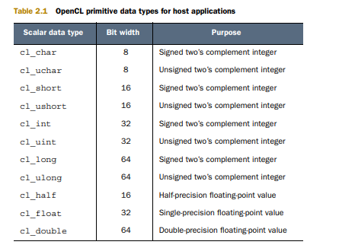

Slide 97
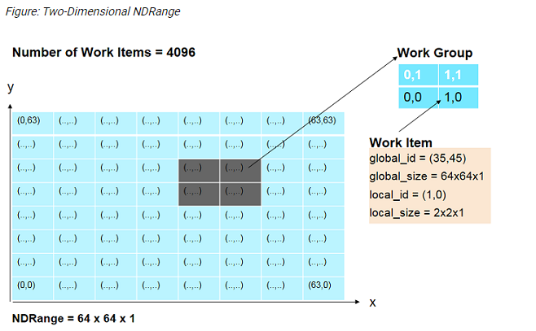

Slide 98
